Slide 1
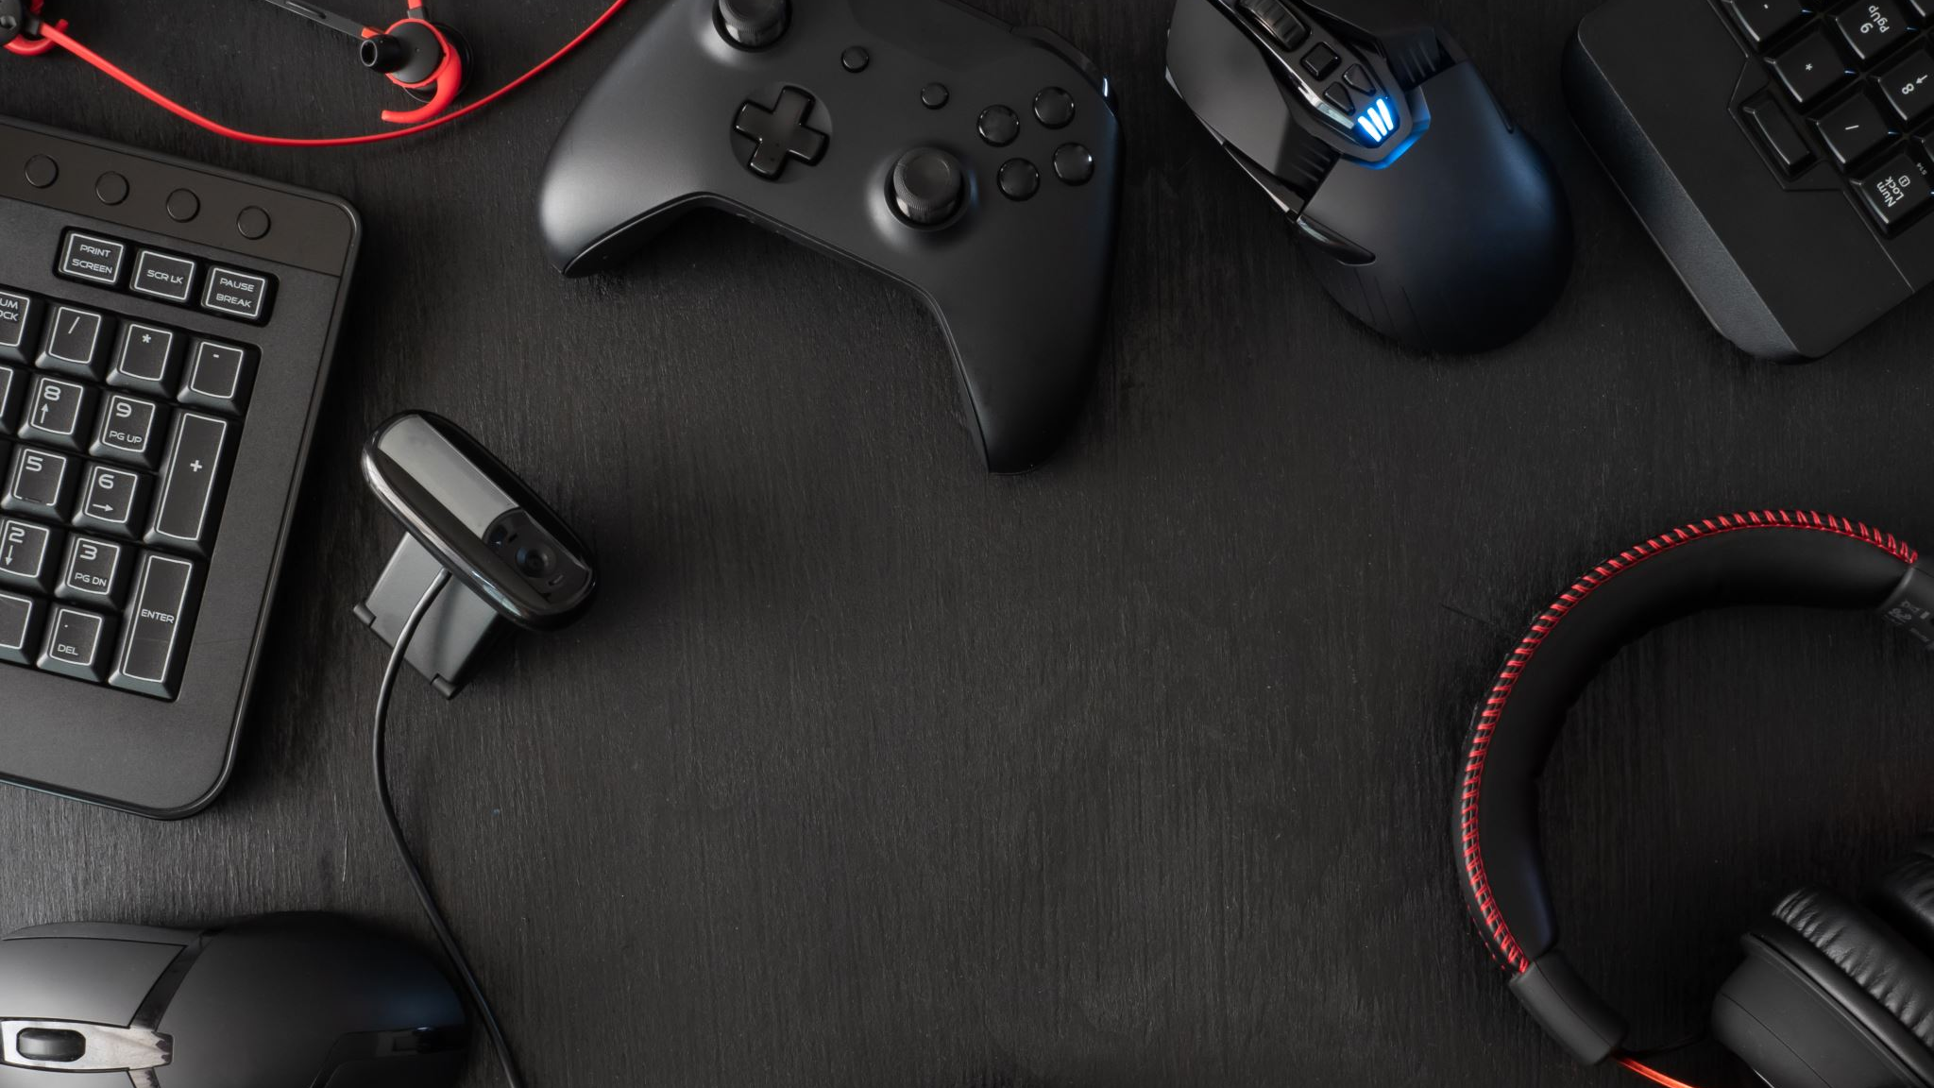
Dungeon Crawler
By MJ Schnee, Nick Bryant, and Freja Kahle
Advisor: Dr. John Gallagher
Notes:
FREJA START

Slide 2

Project Purpose and Goal Statements
Project Purpose
Develop a multiplayer dungeon crawler video game taking inspiration from the Dungeon & Dragons Adventure System board games
Goal Statements
Create a unique set of rules and mechanics for the game.
Allow players to connect online and play with others virtually.
Make a product that’s fun and easy to play with others.

Slide 3
Intellectual Merits
This project will focus on creating a virtual board game which can be played with others across the internet. The rules and mechanics of the game will be inspired by the game loop of the Dungeons & Dragons board games but will be original and unique. Since the game will be virtual, the rules and mechanics can be automated somewhat, which allows us to create mechanics that would not be possible with a physical game, such as automating random encounters. We will be using the Unity game engine to create the game along with the free assets it provides for students. The product should be a fun and unique cooperative online board game.

Slide 4
User Stories
As a player, I want to team up with other players online to form a cooperative party.
As a player, I want to choose a hero from a selection of heroes, each with unique abilities and stats.
As a player, I want to select an adventure from a campaign or standalone quest.
As a player, I want to move my hero across the dungeon tiles to explore new areas.
As a player, I want to fight monsters that spawn on new tiles.

Slide 5
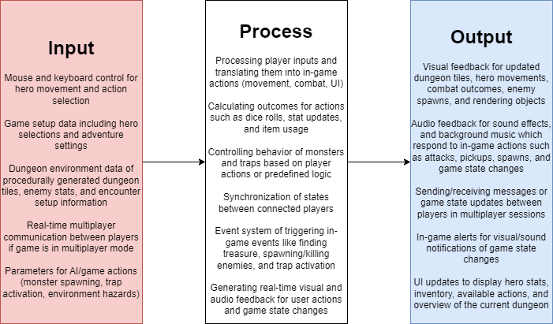
Design Diagram 0

Slide 6
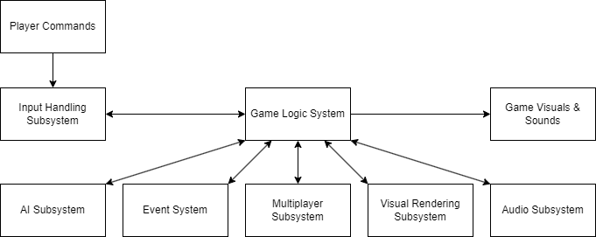
Design Diagram 1

Slide 7
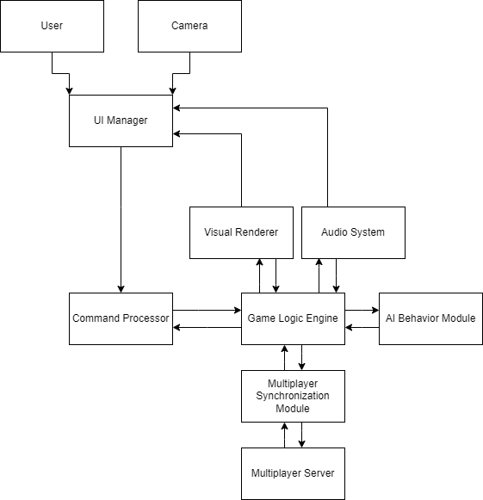
Design Diagram 2

Slide 8
Major Project Constraints
Economics
Ensuring we use open-source assets and free tools as there is no budget
Professionalism
Ensuring we deliver a polished and functional game
Ethics
Ensuring the game is inclusive and accessible for a diverse audience
Legal
Ensuring the game does not infringe upon copyrights and proprietary mechanics
Notes:
NICK START

Slide 9
Results
Created the scene in Unity with characters, movement, enemies, and a User Interface.
We are making a working demo every week that expands our project and completes more of our objectives.
In order to complete our final demo for the expo we are prioritizing functionality of key features such as turn mechanics and random generation to complete our final deliverables.

